Slide 1
EEU Business Plan
UEMS Assembly - KEPKIPA, April 28-29, 2017
An Appraisal & 2017-2018 Budget Proposal

Slide 2
A short history of EEU
Reasons:
UEMS activities are mainly dedicated to improve the quality of medical education in Europe
We need a wider distribution and acceptance of European Guidelines
The project for a web-based platform for continuous medical education of european endocrinologists started in 2012 and was promoted by the President and Secretary of the UEMS-Section of Endocrinology
Approved from the UEMS General Assembly that deliberated its financial support.

Slide 3
A short history of EEU
Results:
Development of an easy to access and friendly to use platform
Production of educational courses based on European guidelines and ESE lectures
Q&A section to link learning activities to European CME credits

Slide 4
Costs
Initial costs for the development of the EEU platform (Lynx Company, Italy)
Annual expenses for production of the courses (Marco Capizzi & Lynx Co)
No fees for the Authors

Slide 5
Operating Income |  | Previsional Budget 2017 | Budget april 2015 - 2016 | Budget april 2014 - 2015 | Budget april 2013 - 2014 | Budget april 2012 - 2013
UEMS |  | 15000 | 15000 | 15000 | 25000 | 25000
ESE |  | Agreements in progress
 | Total |  | 15000 | 15000 | 25000 | 25000
Operating Charges
Project design/Platform creation/Demos | Lynx |  |  |  |  | 15000
 | MC |  |  |  |  | 9700
 | Subtotal |  |  |  |  | 24700
Website mainteinance/support/update | Lynx | 5000 | 5000 | 5000 | 5000
 | Subtotal | 5000 | 5000 | 5000 | 5000
Courses design/coding/revision/testing | Lynx |  |  |  | 7200(1c, 1d)
 | MC | 10000 (4 c) | *4665 (2c) | 10000 (4 c) | 7800(2c)
 | Subtotal | 10000 | 4665 | 10000 | 15000
Trips/Stand organization/Stand work | MC (Copenhagen, Barcellona, Wroclaw confereces/stand) |  | *335 | 1091,96 | 1206,96
 | Subtotal |  | 335 | 1091,96 | 1206,96
CEO/Secretariat work/online coordination platform |  |  | MC + Thomas Scherer investment | MC + Thomas Scherer investment | MC investment | MC investment
 | Subtotal |  | 0 | 0 | 0 | 0
 | Total | 15000 | 10000 | 16091,96 | 21206,96 | 24700
Summary | Residual funds |  | 5000 | 3001,08 | 4093,04 | 300
* to be paid | c: course (2500 for 1 course. 2250 for one course if one invoice for 10 courses) |  |  |  | d: demo | MC: Marco Capizzi

Slide 6
Problems
Mostly based on voluntary activities
Limited financial resources
No editorial board, no secretariat
Very limited diffusion
Lack of involvement of the national & european endocrine societies

Slide 7
Needs
Cooperation with the (european and/or national) endocrine societies
Need of a stable staff/organization
Enlarged financial support
Back-up informatic company
Decrease of the costs of courses

Slide 8
Perspectives: Competition analysis
Current cost for a CME Course: 40-150 euro
Current cost for platform subscription (eg, UptoDate): about 500 euro/year
Limits:
- USA-based
- mostly internal medicine contents
- nearly no contribute from european experts

Slide 9
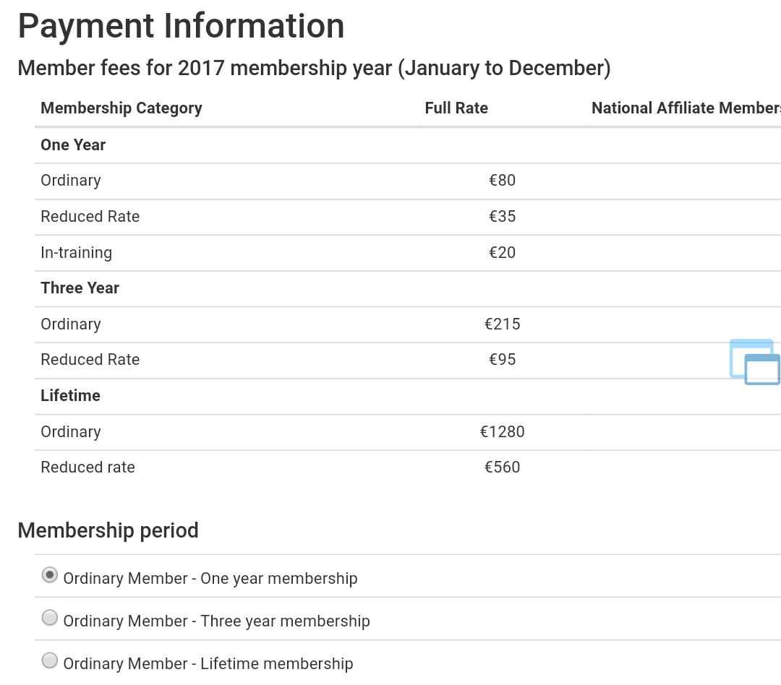
Target analysis
3000 ESE endocrinologists
About 15000 european endocrinologists (?)
Endocrinologists which are not ESE members and need continuous education: 10000 (?)
ESE subscription costs:

Slide 10
What could we do?

Slide 11
Operating plan
EEU Association Act modified and co-signed by ESE ?
Equal number of UEMS and ESE members in the Board ?
As an alternative: formal cooperation with the National Endocrine Societies ?
New EEU statute shold be registered

Slide 12
Operating plan: Options
2018 Website maintenance & Update
20 courses/year (various areas)
Authors
Reviewers
Editorial secretariat
Backup Company (beside Lynx, able to cooperate with Lynx and to work on the same website)
The Company should be ready to backup Lynx whenever necessary. Costs could be decreased.

Slide 13
Communication and Promotion
Newsletter/mailing list by ESE to promote courses, or
Link and newsletter by National Endocrine Societies
Coupon code
Registration may ensure a microrevenue for the National Societies (e.g. 0.2 – 2 euro/registration through coupon every year)

Slide 14
Economic plan/year
Website maintenance: 5000 euro
20 courses per year
Authors: self explanatory ppt course plus background and Q&A reward: free ESE subscription for one year or 50 -150 euro (?)
Reviewers & website workers
costs: 1500 euro (?) each course for 20 courses
Secretariat: workflow prepared and standardized costs:150 euro (?) for each course

Slide 15
Economic plan/year (2)
Non-ESE members: 10% of courses free & 90% paid (?)
ESE members: 100% free (coupon code)
ESE members could maintain free access to the platform paying their fees
Similar opportunities with National Societies.

Slide 16
Financial Plan
Each year
Costs: 36000 euro
[20 courses (1500+150+150 euro) x 20]
Financial support: half from UEMS & half from ESE ?
Financial support from National Societies ?
Income from subscriptions ?

Slide 17
Financial Plan (2)
Further potential Incomes
Pharma industries unconditioned grant to a registered EEU foundation
eg: 5 - 10000 euro each company
(4 industries: 20 - 40000 euro/year)

Slide 18
Conclusions
We have a highly effective educational tool and the opportunity to make more homogeneous continuous education in endocrinology
Currently, no major competitors in the European area
We need cooperation with the Scientific Societies to make this tool an actual part of the educational activities of all european endocrinologists
We need further sources of financial support.

Slide 19
Conclusions: Road to Cooperation
Conclusive agreement (or disagreement) with the ESE
Presentation of the platform to the Presidents of the National Endocrine Societies in a dedicated meeting (eg, ETA, EASD, ….)
Formal meeting with the Presidents of the National Endocrine Societies

Slide 20
Thank You

Slide 21
Operating Income |  | Previsionale budget 2018 | Budget 2017 | Budget april 2015 - 2016 | Budget april 2014 - 2015 | Budget april 2013 - 2014
UEMS |  | 15000 | 15000 | 15000 | 15000 | 25000
ESE |  | Agreements in progress
 | Total |  |  | 15000 | 15000 | 25000
Operating Charges
Project design/Platform creation/Demos | Lynx
 | MC
 | Subtotal
Website mainteinance/support/update | Lynx | 5000 | 5000 | 5000 | 5000 | 5000
 | Subtotal | 5000 | 5000 | 5000 | 5000 | 5000
Courses design/coding/revision/testing | Lynx | 15000 (10c) |  |  |  | 7200(1c, 1d)
 | MC | 15000 (10c) |  | *4665 (2c) | 10000 (4 c) | 7800(2c)
 | Subtotal | 15000 (20c/2) |  | 4665 | 10000 | 15000
Trips/Stand organization/Stand work | MC (Copenhagen, Barcellona, Wroclaw confereces/stand) |  |  | *335 | 1091,96 | 1206,96
 | Subtotal |  |  | 335 | 1091,96 | 1206,96
Other (CEO/Secretariat work/online coordination platform/ Authors/ National associations) |  | 6000 (3000 sec + 3000 authors, 20 c) + 2400 N.A. |  | MC + Thomas Scherer investment | MC + Thomas Scherer investment | MC investment
 | Subtotal | 4200 (8400/2) |  | 0 | 0 | 0
 | Total | 19200 | 5000 | 10000 | 16091,96 | 21206,96
Summary | Residual funds |  | 13001,08 | 3001,08 | 4093,04 | 300
* to be paid | c: course (2500 for 1 course. 1500 for one course if one invoice for 20 courses) |  |  |  | d: demo | MC: Marco Capizzi

