Slide 1
EEE-FEEL award winners

Slide 2
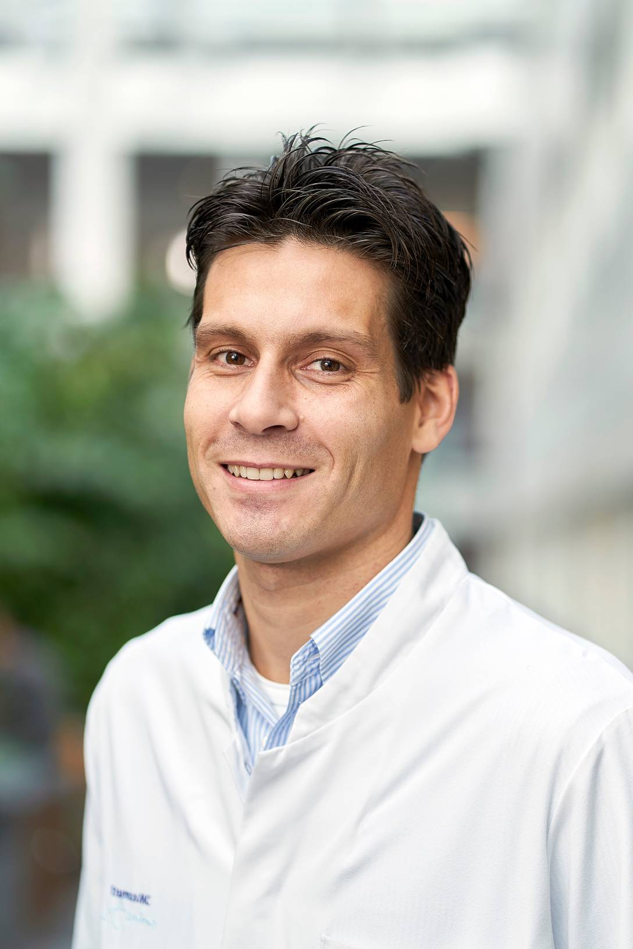
Edward Visser
Winner 2016
From NL to
Now working at Erasmus MC, Rotterdam

Slide 3
Maria Baldassare
Winner 2017
From Italy to
Now working at Università degli Studi G. d’Annunzio Chieti-Pescara

Slide 4
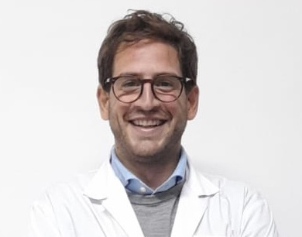
Riccardo Pofi
Winner 2017
From Italy to UK
Now working at the Oxford Diabetes Centre

Slide 5
Mirela-Diana ILIE
Winner 2017
Romania to France
Now working in Lyon, France Cancer research centre

Slide 6
Aleksander Kus
Winner 2017
From Poland to
Now working in Warsaw, medical university, department of internal medicine and endocrinology

Slide 7
Manuela Schoeb
Winner 2019
Switzerland to Leiden, NL
Now working at Kantonsspital St.Gallen, Switzerland

Slide 8
Olga Karapanou
Winner 2019
From Greece to Italy
Now working in 401 Military Hospital, Greece

Slide 9
Pedro Marques
Winner 2019
From Portugal to
Now working: Scientific Programmes Executive at European Society of Endocrinology
And Consultant Endocrinologist at Hospital CUF Descobertas, Lisbon, Portugal

Slide 10
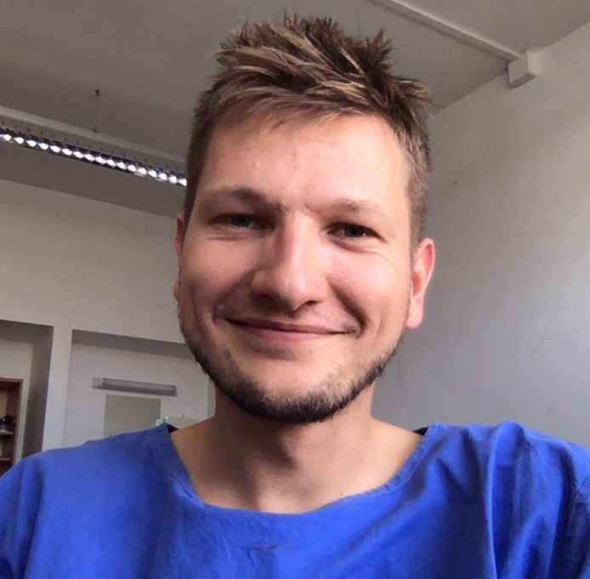
Peter Wolf
Winner 2020
Austria to France
Now working at the medical university of Vienna

Slide 11
Eva Coopmans
Winner 2020
From the Netherlands to
Now worling at the Maasstad Hospital NL

Slide 12
List of winners
2012 Aaron Liew, Waterford (Ireland) to Newcastle upon Tyne
2013 Lemonia Matthiopoulou, Athens to Newcastle upon Tyne
2014 Giulia Brigante, Modena to Rotterdam
2016 Agnieszka Pazderska, (Poland to Newcastle-upon-Tyne
2016 Maria Pavlatou, Athens to Newcastle upon Tyne
2016 Edward Visser , Rotterdam to
2016 Kyritsi
2016 Prete
2016 Sendur

Slide 13
2017 Tim Korevaar, Rotterdam to Paris
2017 Lang Lehrskov
2017 Mirela-Diana Ilie, Romania to France
2017 Riccardo Pofi, Italy to UK
2017 Olga Karapanou, Greece to italy
2017 Aleksander Kus , Poland to
2017 Maria Baldassare, Italy to
2018 Claudia Ress, Innsbruck to Düsseldorf
2019 Pedro Marques , Portugal to
2019 Dionysos Chartoumpekis , Greece to
2019 Manuela Schoeb, Switserland to Leiden
2020 Peter Wolf, Vienna to France
2020 Eva Coopmans, Netherlands to London

